Slide 1
L6- HOMEWORK [Answer any 2 questions.]

Slide 2
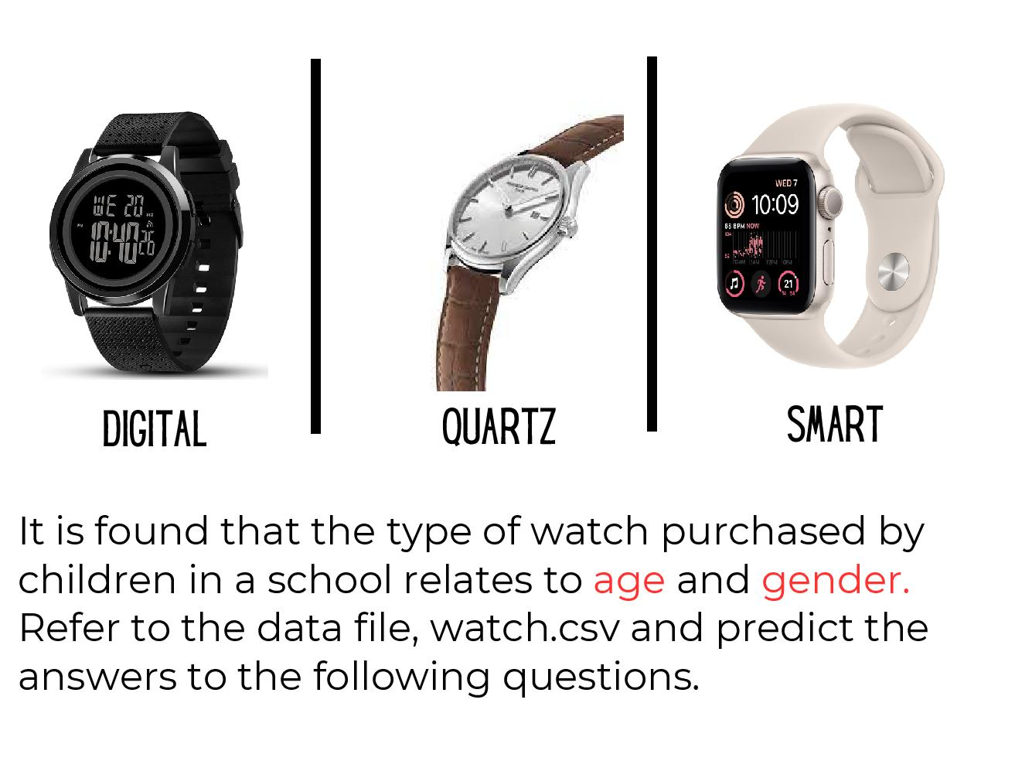
Question 1

Slide 3
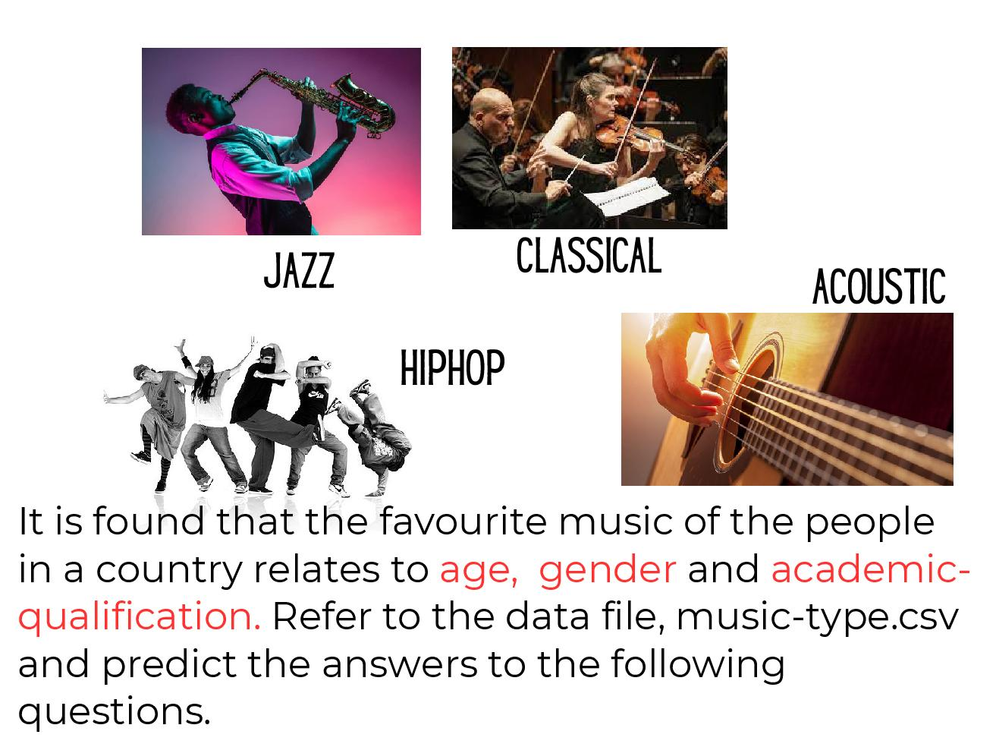
Question 2

Slide 4

Question 3

Slide 5
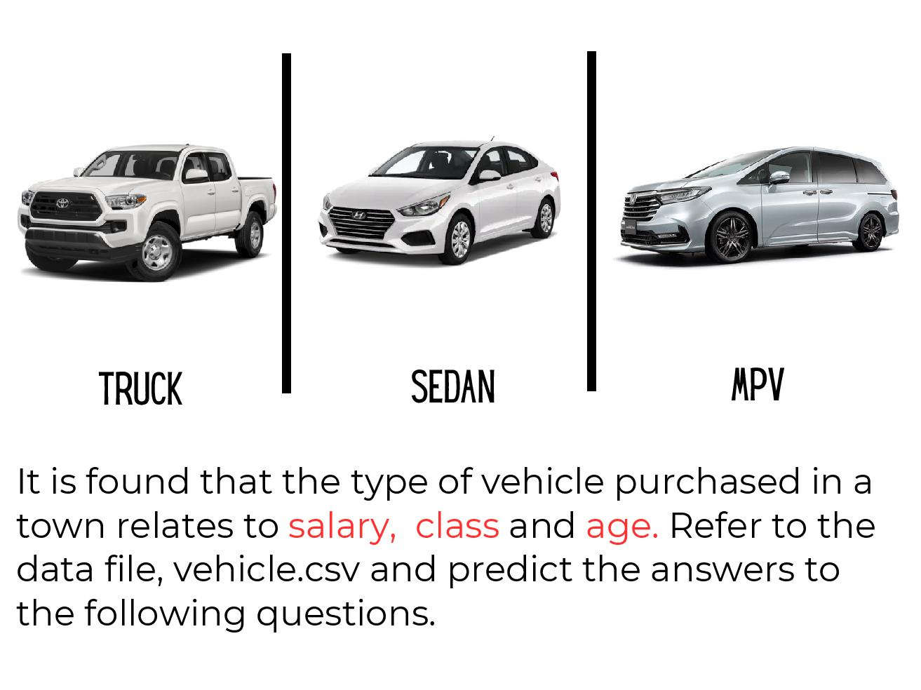
Question 4

Slide 6
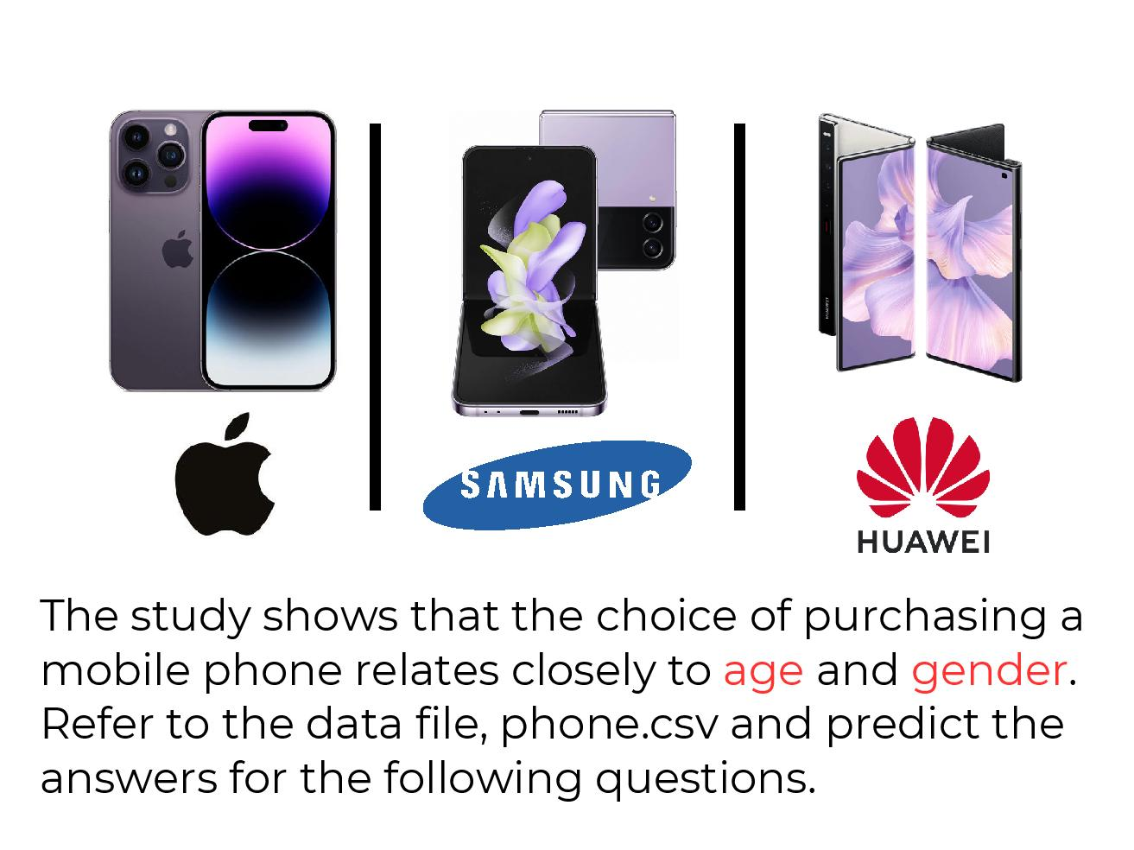
Question 5

Slide 7
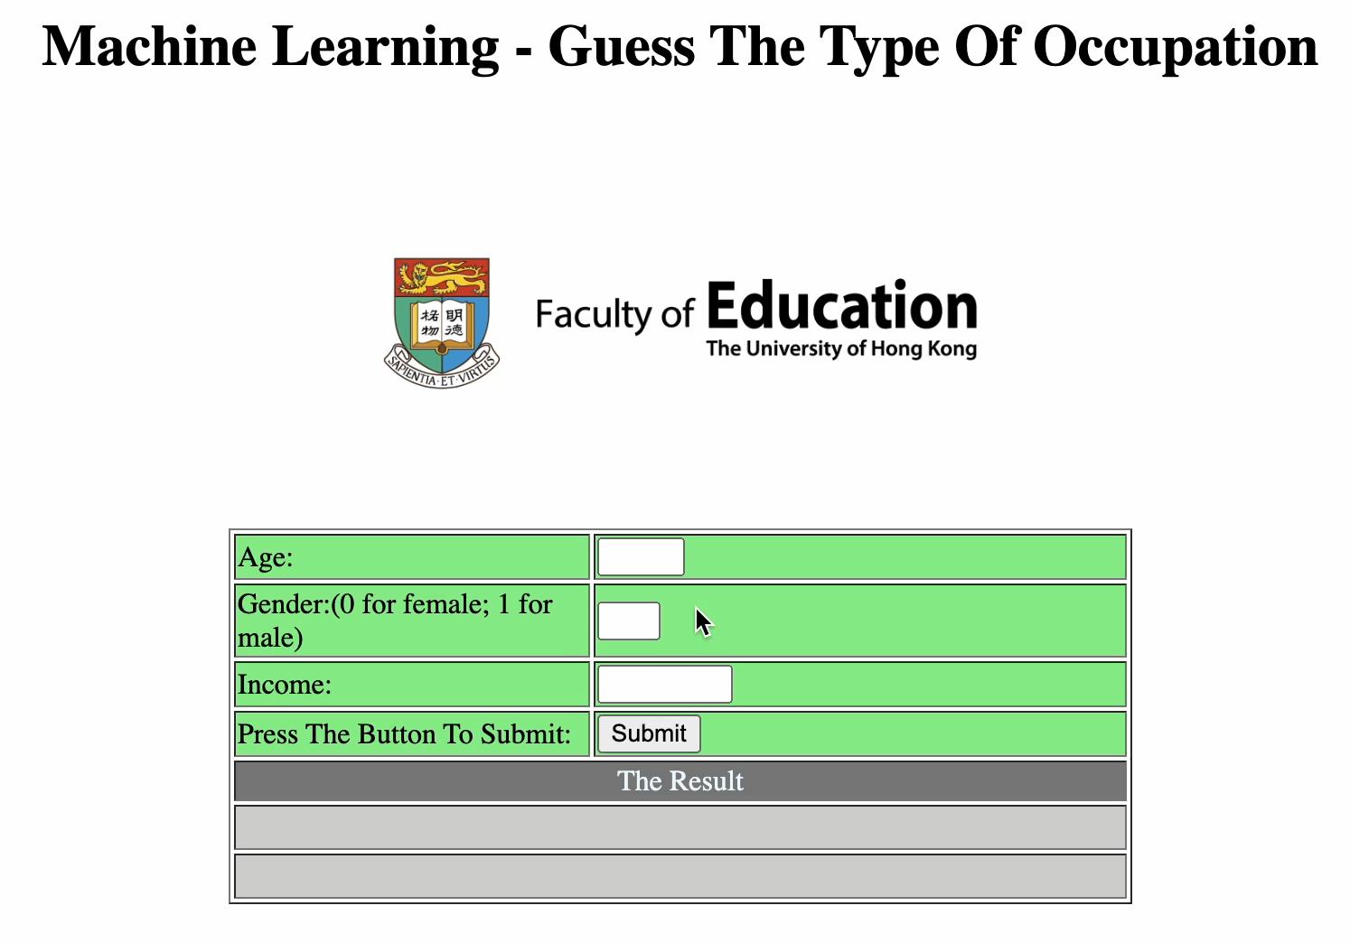
You may consider to improve your output as the video clip below (optional).

